Slide 1
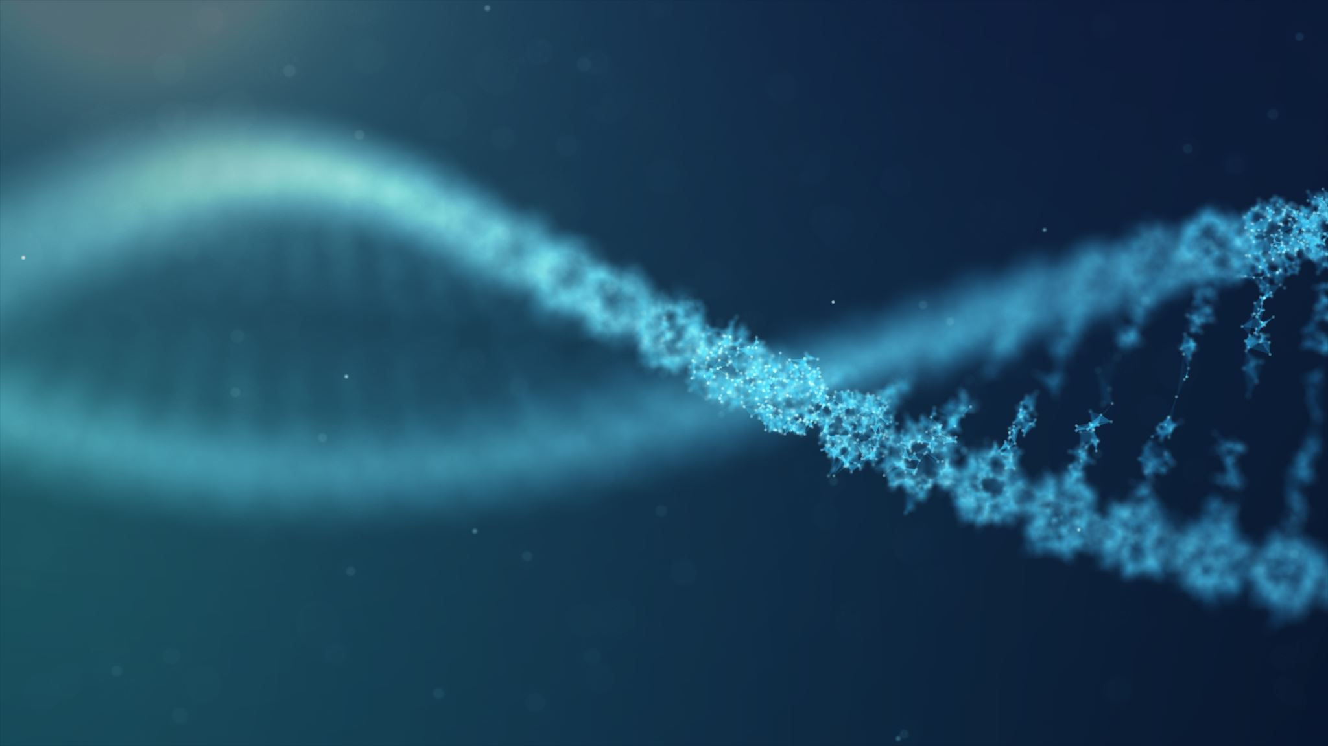
DeepGRN: transcription factor binding site prediction using attention-based deep neural networks – Review
Deepro Banerjee
Mahony Lab Journal Club
09/21/2021
Notes:
Title Slide

Slide 2
Reasons for choosing this paper
Directly aligned to our research area
Supplements current state-of-the-art deep learning models with an attention mechanism and achieves comparable/superior performance
Claims that attention mechanism can improve model interpretation

Slide 3
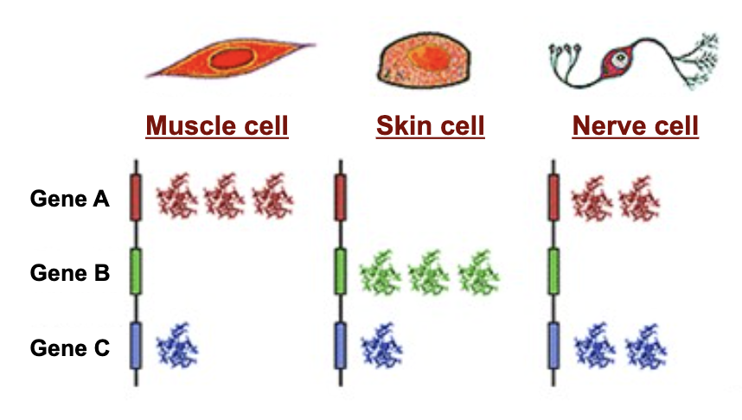
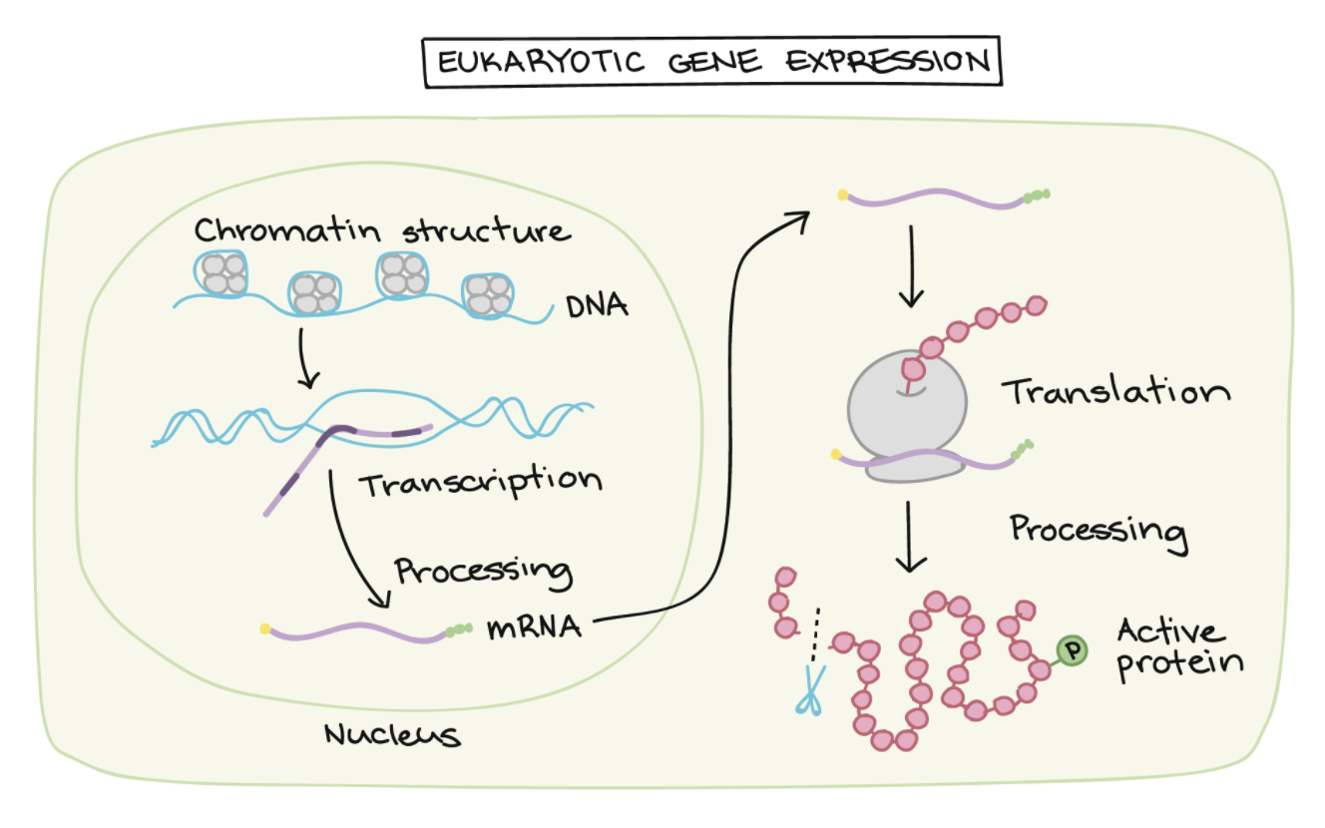
Cell types differ due to gene expression differences
Same DNA – Different functions
Various stages of Gene Regulation
Notes:
Figure1: https://slideplayer.com/slide/9089748/
Figure3: https://www.khanacademy.org/science/ap-biology/gene-expression-and-regulation/regulation-of-gene-expression-and-cell-specialization/a/overview-of-eukaryotic-gene-regulation
Same DNA different cell types
https://www.ncbi.nlm.nih.gov/Class/MLACourse/Original8Hour/Genetics/gene_expression.html
https://www.nature.com/scitable/topicpage/gene-expression-regulates-cell-differentiation-931/
https://www.nature.com/articles/hdy201054

Slide 4
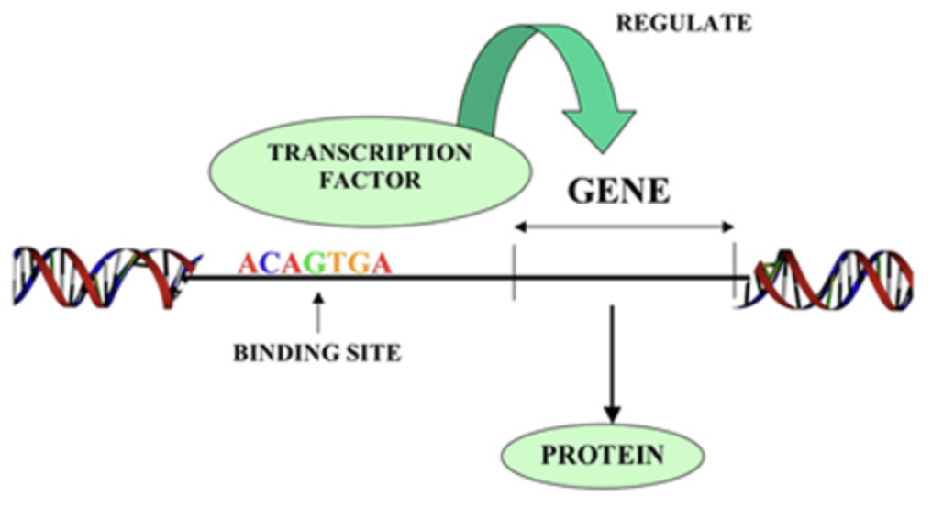
Transcription Factors regulate gene transcription
TFs are proteins that play a central role in regulating gene transcription
ChipSeq “golden standard”; however experimental determination of all possible cell types across all species is infeasible
Notes:
Figure2: http://2013.igem.org/wiki/index.php?title=Team:XMU_Software/Project/promoter&oldid=359507
TF Background
Khan Academy: https://www.khanacademy.org/science/biology/gene-regulation/gene-regulation-in-eukaryotes/a/eukaryotic-transcription-factors
http://2013.igem.org/wiki/index.php?title=Team:XMU_Software/Project/promoter&oldid=359507
https://www.nature.com/articles/nrg3207

Slide 5
Deep Learning models show superior performance
Conventional Models | Deep Learning Models
Handcrafted Features | Automatic high level feature learning
Not easily scalable | Can be trained in batches and in parallel
Worse performance | Better performance
Examples: Hidden Markov Models, Support Vector Machines, Random Forests | Examples: DeepBind/DeepSEA (CNNs), DanQ/DeeperBind/FactorNet (CNN + RNN)
Notes:
DeepBind: https://www.ncbi.nlm.nih.gov/pmc/articles/PMC4908339/
DeepSEA: https://www.ncbi.nlm.nih.gov/pmc/articles/PMC4768299/
DanQ: https://www.ncbi.nlm.nih.gov/pmc/articles/PMC4914104/
DeeperBind: https://www.ncbi.nlm.nih.gov/pmc/articles/PMC7302108/
FactorNet: https://pubmed.ncbi.nlm.nih.gov/30922998/

Slide 6
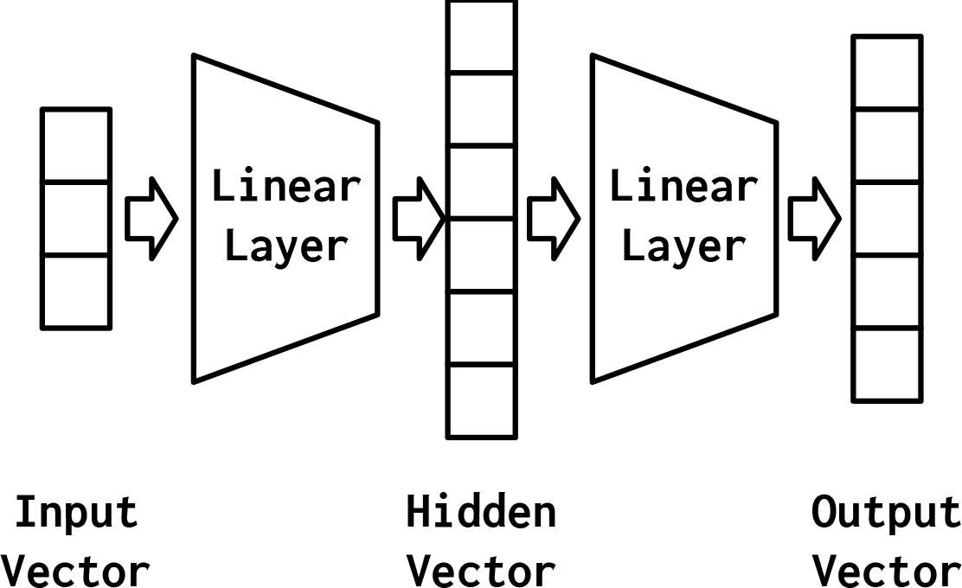
Multi-layer perceptron is good at summarizing tasks
W^{T} . x + b
𝛔 (W^{T} . x + b)
Also referred to as Feedforward networks/Dense layers/Fully connected layers
Notes:
Figure4: https://www.oreilly.com/library/view/natural-language-processing/9781491978221/ch04.html

Slide 7
Convolutional Neural Network can find patterns
A
T
T
A
A
C
A
C
A
A
G
A
A
C
A
0.8
0.7
0.5
0.2
CNNs are used to find sequence motifs where the Transcription Factor might bind
Notes:
CNN explanation:
https://machinelearningmastery.com/convolutional-layers-for-deep-learning-neural-networks/

Slide 8
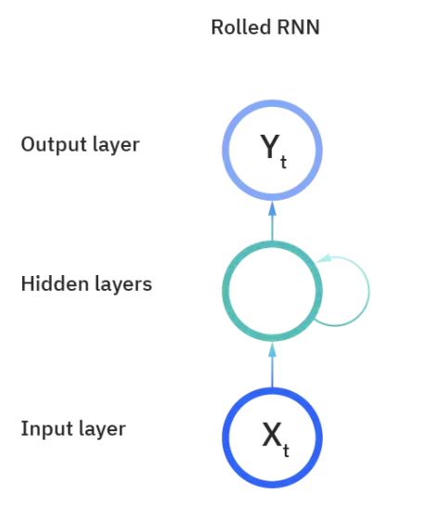
Recurrent Neural Network can learn context
Y₁
Y₂
Y_{t-1}
Y_{t}
Y_{n}
…
…
X₁
X₂
X_{t-1}
X_{t}
X_{n}
Notes:
Figure: https://www.ibm.com/cloud/learn/recurrent-neural-networks
RNN explanation:

Slide 9
Current CNN-RNN state-of-the-art architecture
MLP
CNN
RNN
ATTAACACAAGAACA
INPUT
CNN
RNN
MLP
OUTPUT
CNN will capture motif/motifs
RNN will capture context within and between motifs

Slide 10
Attention is all you need
Y
…
…
MLP
Y
…
…
X₁
X₂
X_{t-1}
X_{t}
X_{n}
Notes:
Original Attention Paper: https://arxiv.org/pdf/1409.0473.pdf
Transformer: https://arxiv.org/pdf/1706.03762.pdf
Attention Mechanism Explanation:
https://towardsdatascience.com/intuitive-understanding-of-attention-mechanism-in-deep-learning-6c9482aecf4f

Slide 11
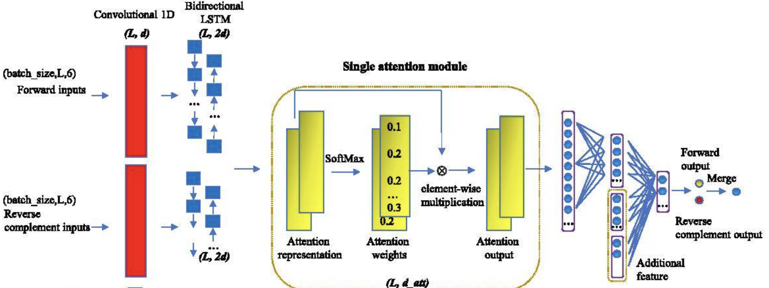
Model Architecture

Slide 12
Study Design under DREAM challenge restrictions
Problem Statement: Transcription Factor binding prediction across cell types
Features: DNA Sequence (S), DNase-Seq (S), RNA-Seq (NS)
Target: Bound/Unbound
Training
All Chrm except 1,8,11,21
Validation
Chrm 11
Test
Chrm 1, 8, 21
Cell type 1
Cell type 1
Cell type “test”
Cell type 2
Cell type 2
.
.
.
.
Cell type k
Cell type k

Slide 13
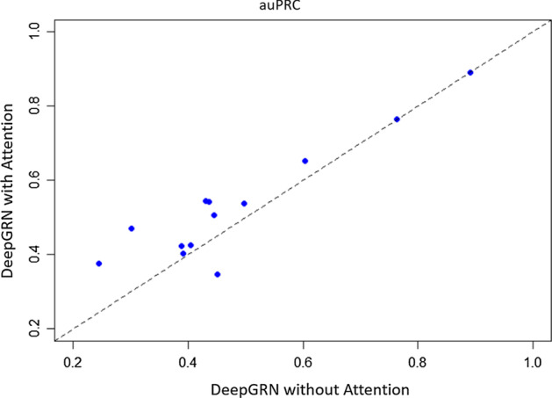
DeepGRN w and w/o attention

Slide 14
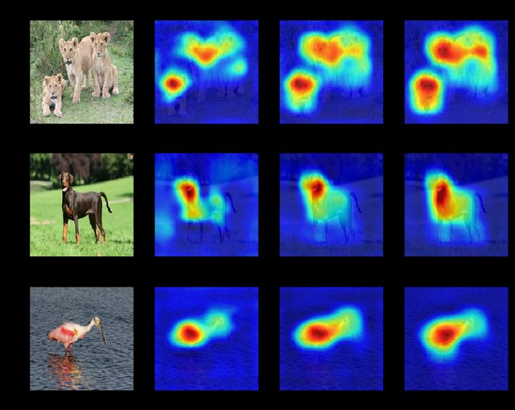
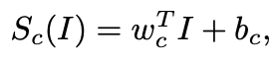
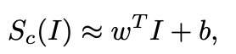
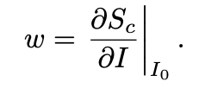
Saliency maps can highlight prominent regions
Linear model scoring function:
Non-Linear model scoring function approximated as linear :
1st order
Taylor series expansion
Notes:
Figure 8: https://www.geeksforgeeks.org/what-is-saliency-map/
Saliency Maps:
https://arxiv.org/pdf/1312.6034.pdf
https://towardsdatascience.com/saliency-map-using-pytorch-68270fe45e80

Slide 15
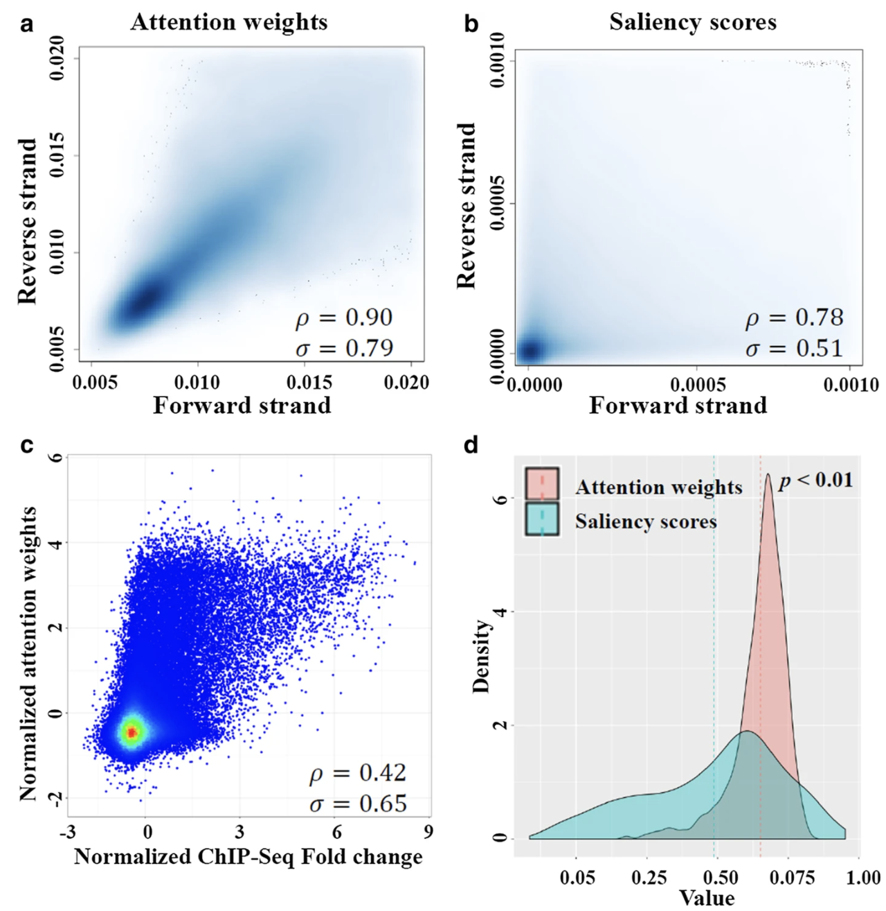
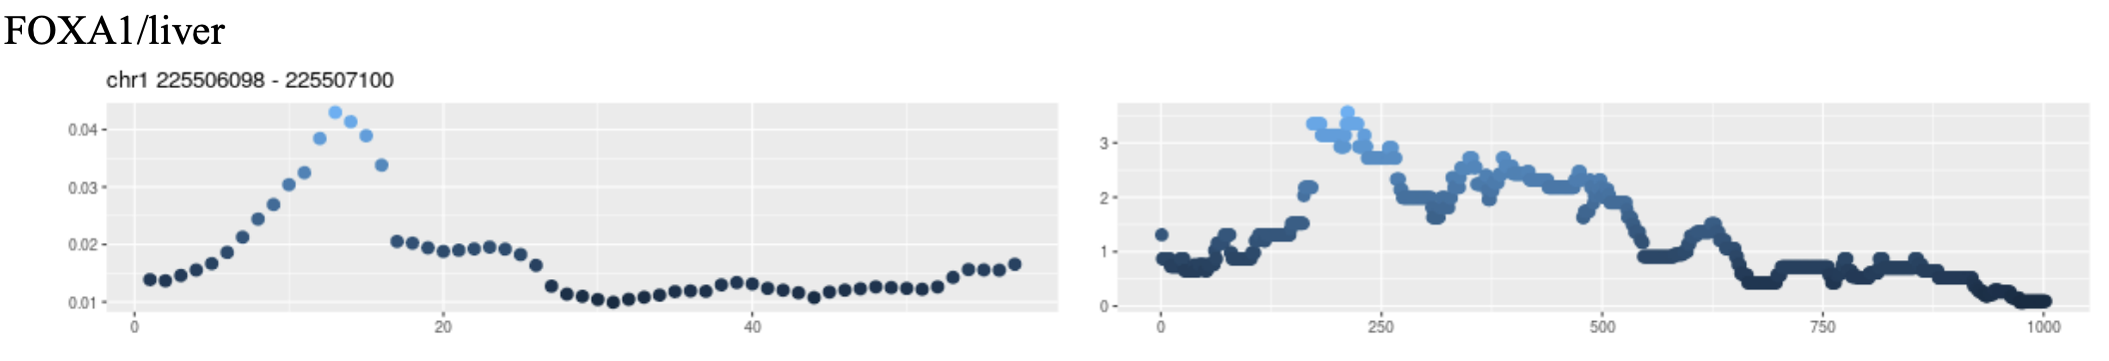
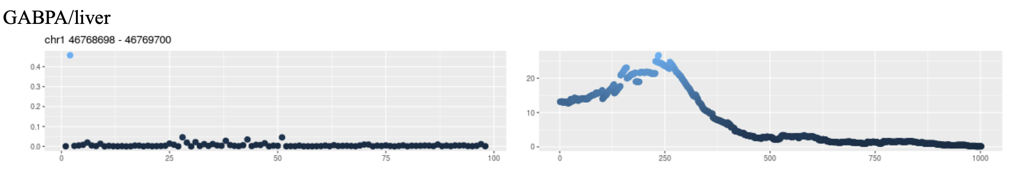
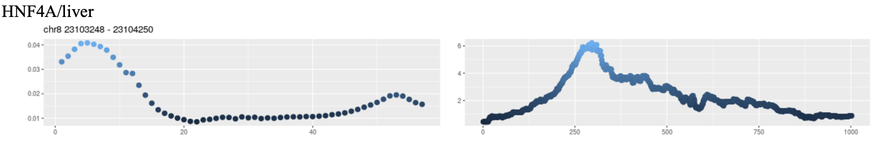
Attention weights can highlight binding locations

Slide 16
Discussion
Attention layer showed significant improvement in some cell types
When should we avoid attention?
Attention weights provide an additional mechanism to interpret models
Comments about instances where attention weights did not correlate with chip-seq peaks?

Slide 17
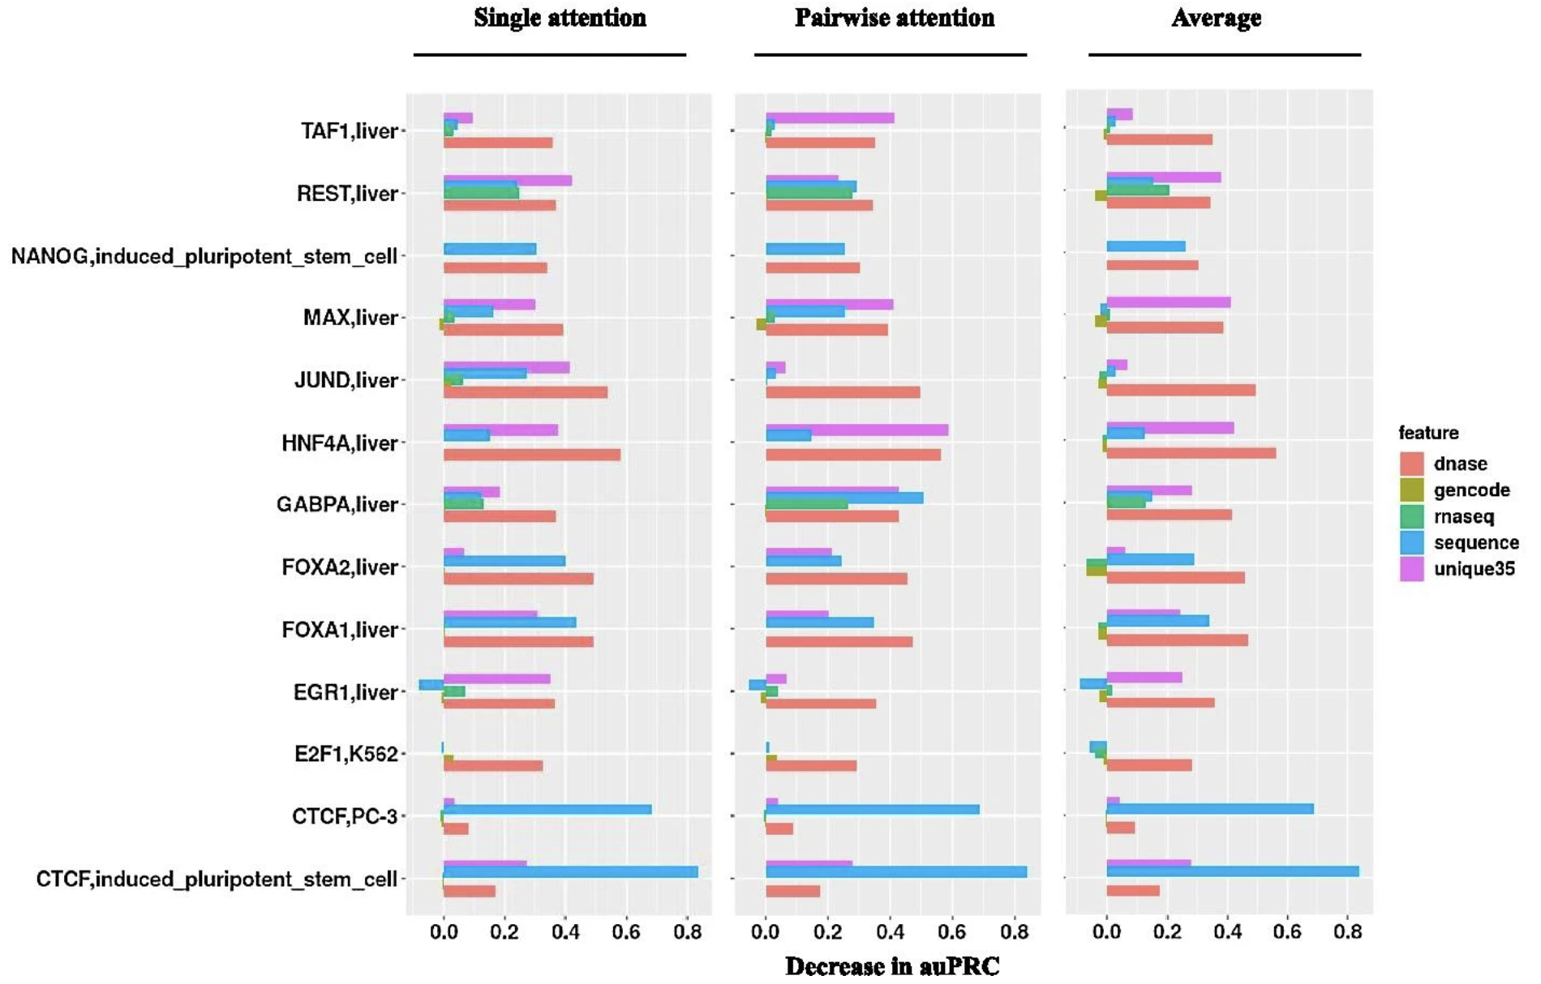
Appendix – Feature Importance

Slide 18
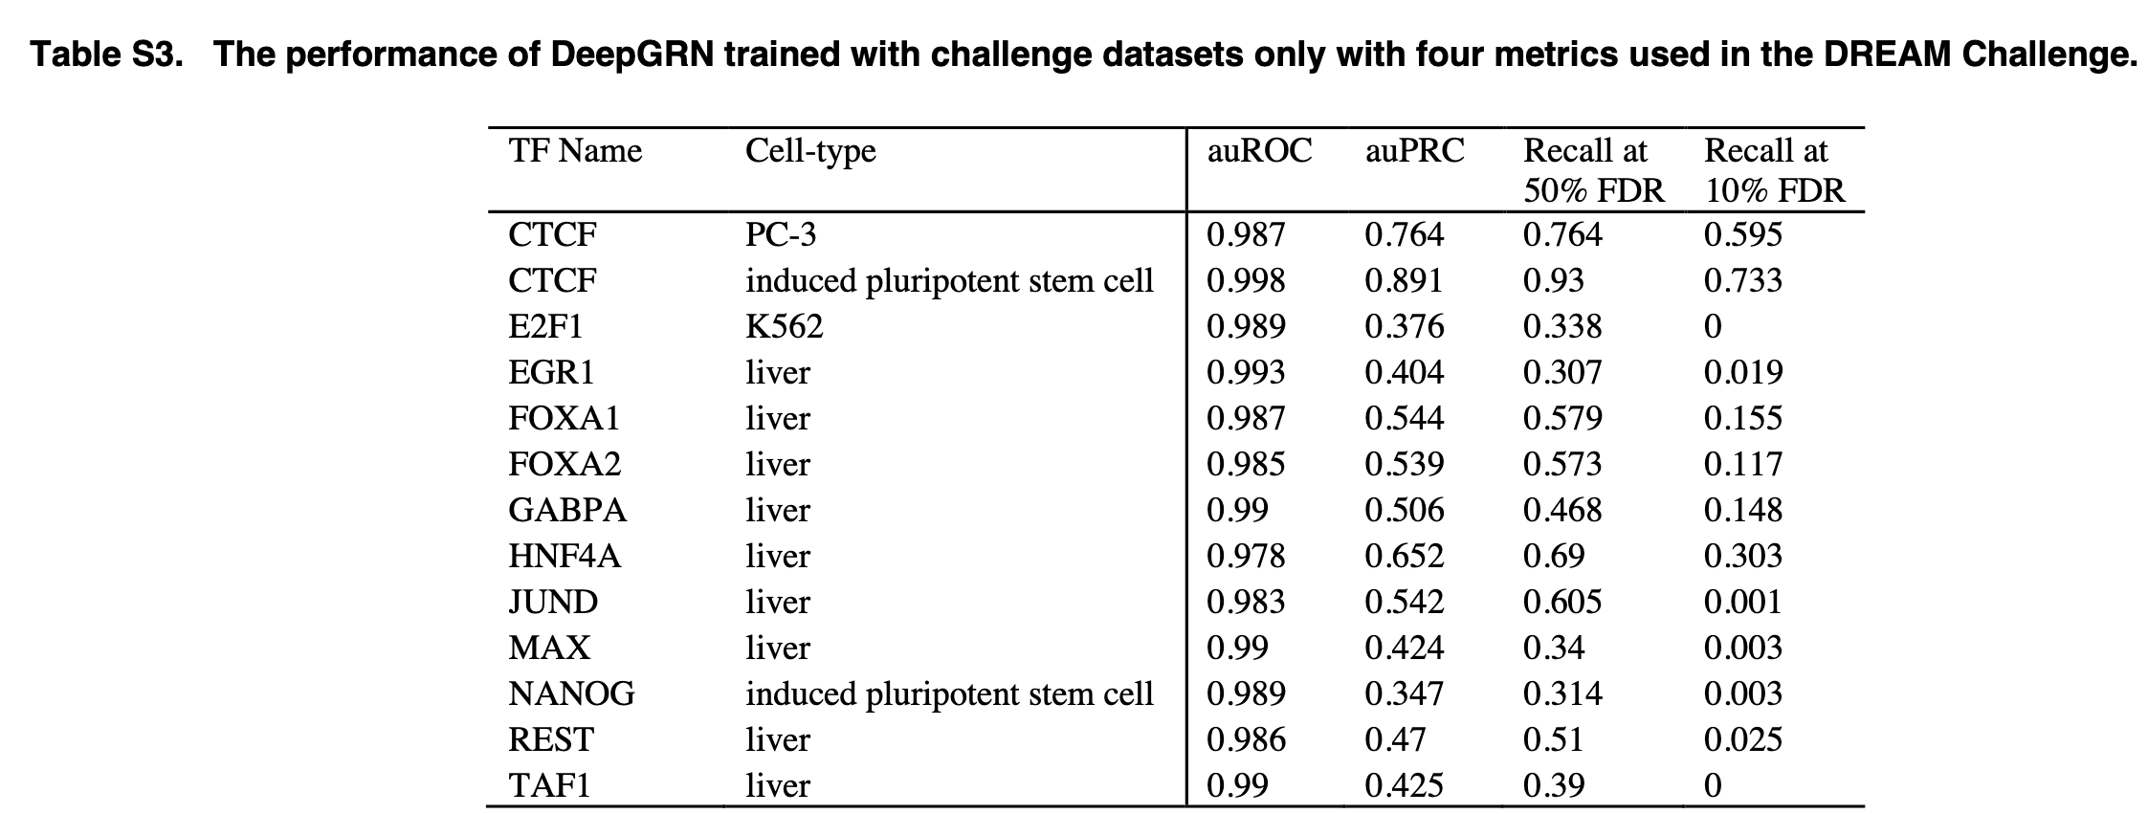
Appendix – Model scores for DREAM challenge

Slide 19
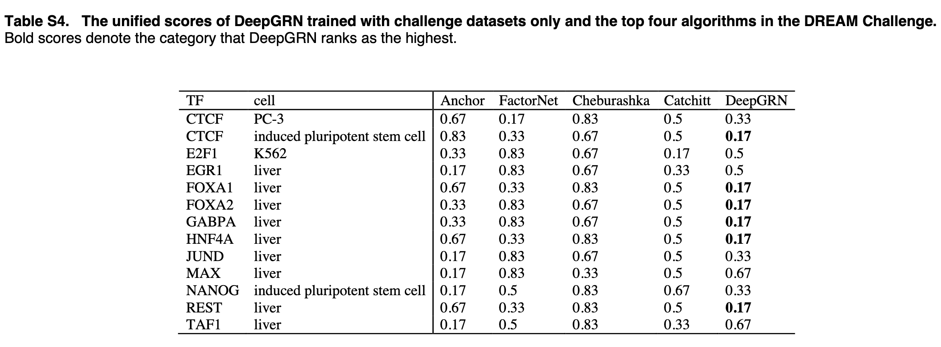
Appendix – Model scores for DREAM challenge

Slide 20
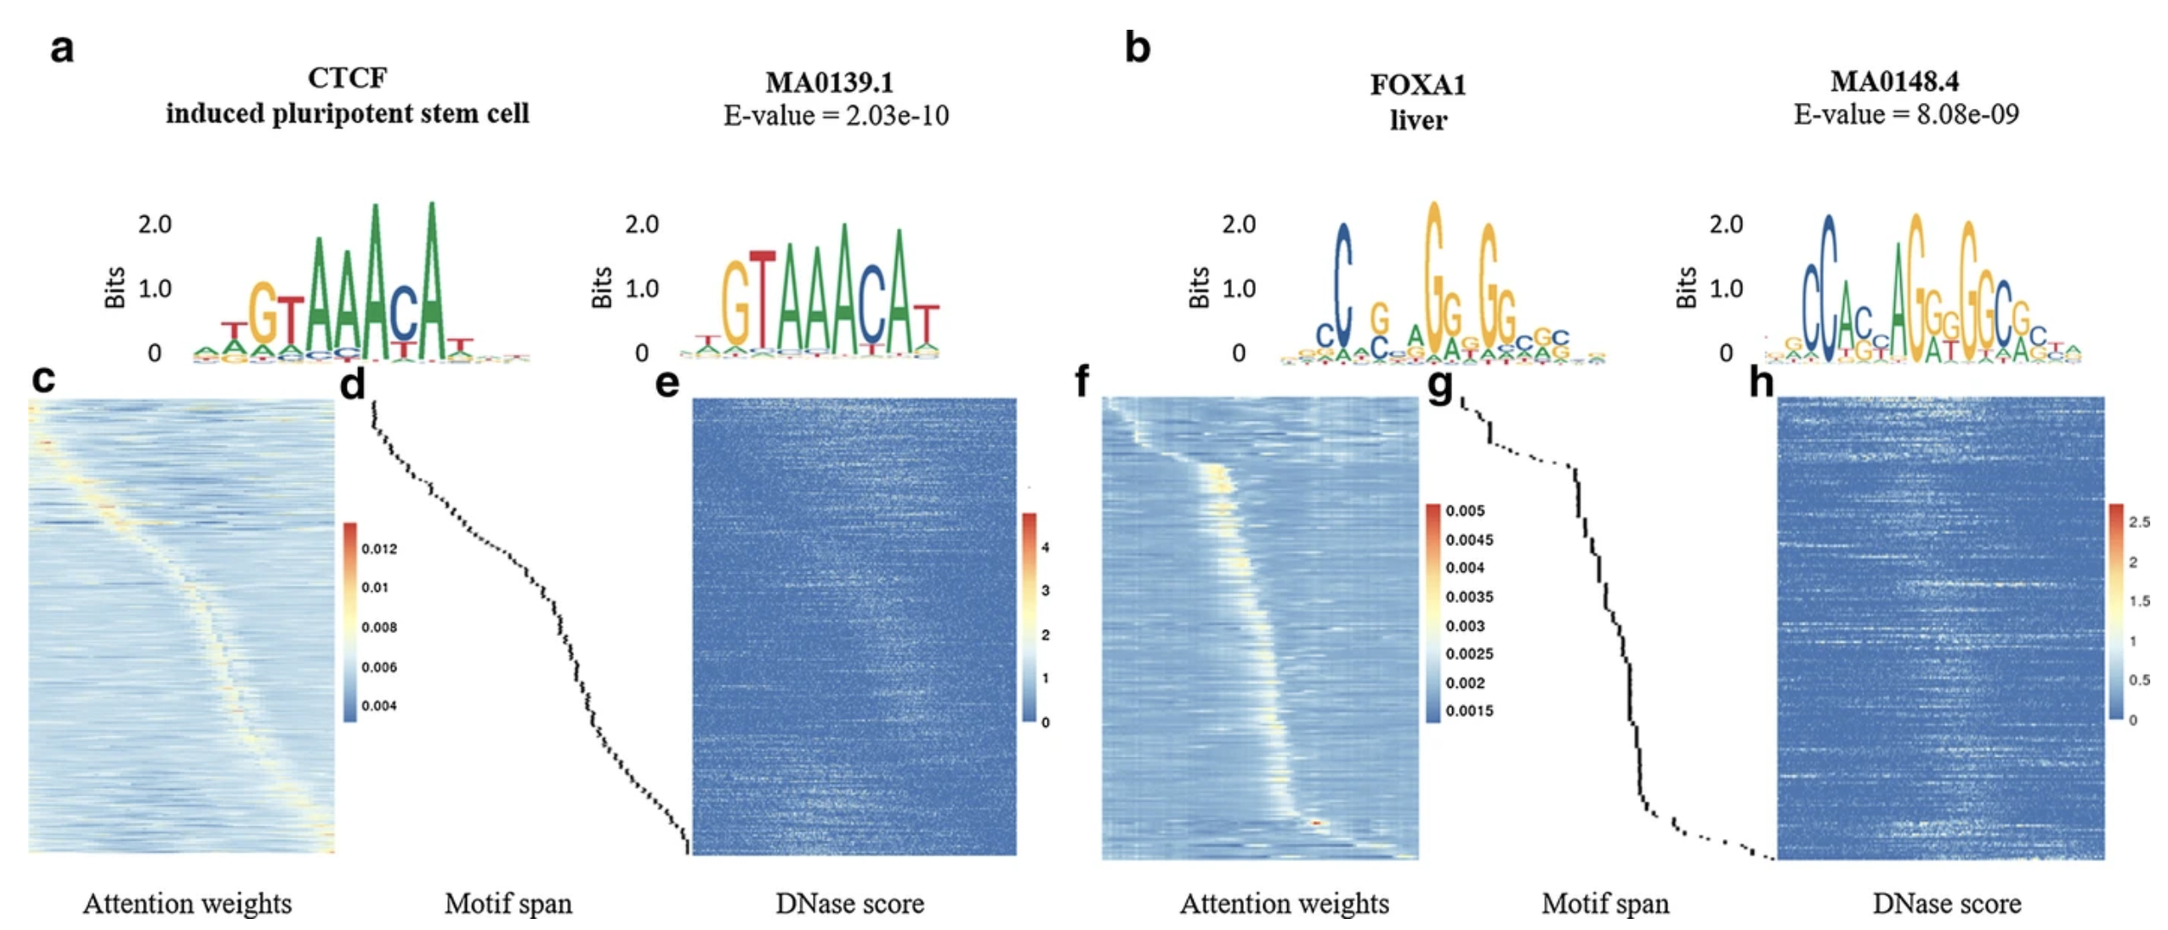
Appendix – Motif detection

Slide 21
Appendix – Saliency Features
Notes:
https://arxiv.org/pdf/1312.6034.pdf
https://www.nature.com/articles/s41576-019-0122-6#Sec11
https://glassboxmedicine.com/2019/06/21/cnn-heat-maps-saliency-backpropagation/
https://towardsdatascience.com/saliency-map-using-pytorch-68270fe45e80
Getting a linear approximation of the non-linear function at a point a, using a Taylor’s series expansion: https://en.wikipedia.org/wiki/Taylor%27s_theorem

Slide 22
References
DNaseSeq vs ATACSeq: https://genomebiology.biomedcentral.com/articles/10.1186/s13059-019-1654-y

